Slide 1
Does India prosper as the number of people being Educated at least at a primary level increase?
Rohith Soman

Slide 2
Dataset
World Development Indicators Dataset

Slide 3
Motivation
Indians are usually considered smart. But still there are a lot of people who are mostly in a backward position in the community who do not have access to even primary education or simply can’t afford it. The Govt. has been taking measures to tackle these problems by opening more and more Govt. operated schools and provide basic education to the people for free.
So here we are going to analyze if the number of people who at least get a primary education increase, does the country prosper?
Also, in the 70s and 80s, a girl child was considered inferior to a boy child and they were not provided with the same facilities and education which a boy gets. Here we will also see whether the mentality of the people who consider a boy superior to a girl has changed and started to provide equal opportunities of education as time went by.

Slide 4
Research Problem 1
Does India prosper as the number of people being educated at least at a primary level increase?

Slide 5
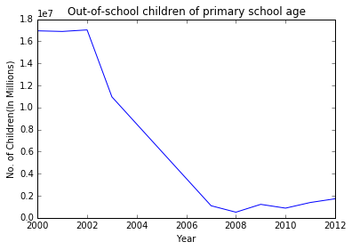
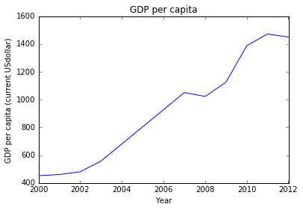
Observations and inferences
Figure 1(a) : variation in the number of out-of school students of primary school age over a decade(in millions),
(b) : variation in the GDP Per Capita (Current US Dollar) over a Decade (in USD)
Till 2002-2003, the number of kids out of school were huge (~ 1.7 million) and the GDP of India was almost in a saturated state during that period as we could observe from fig 1(b).
Comparing fig 1 (a ) and 1(b), it can be concluded that, the prosperity of a nation is directly linked to its literacy rate. As the out-of school student number decreases with passing years (fig 1(a)) , we could observe a proportional rise in the GDP (fig 1(b)).
(a)
(b)

Slide 6
Research Problem 2
Has the mentality of the people who consider a boy superior to a girl changed?
Are they provided equal opportunities to educate themselves as years passed?

Slide 7
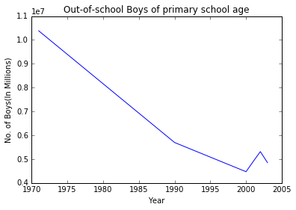
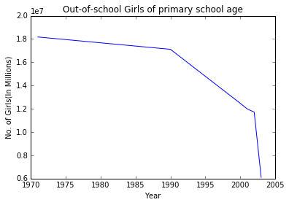
Observations and inferences
(a)
Until late 80’s, education facilities were provided more for boys compared to girls. Boys were educated more as is evident from fig 2(a) and (b). The number of out of school girls is quite huge compared to that of boys., the difference being of the order of approximately 10 million.
The number of out of school students decrease as time flows. In the case of boys, there is a steep decrease (fig 2(a)) whereas, for girls (fig 2(b), the decrease is a gradual process.
During 1970- 1990, there is hardly any reduction in the out of school girls, (fig 2(b)), depicting the slow evolution of the mind set of society towards. However, this change is quite rapid for the case of boys (fig 2(a)).
By 21st century beginning, the modern society has changed and equal education opportunities are found to be provides to school age children irrespective of their gender. Towards the end of 2003, we could observe a similar trend in the number of out of school students (boys and girls)
(b)
Fig : 2 Variation in the number of out of school students of primary age over a period has been shown. (a) and (b)shows the number of boys and girls (in million) respectively

Slide 8
Conclusions
Prosperity of a nation has direct link to the literacy rate. It has been observed that GDP of India has sharply risen owing to its fast growing literacy rate.
Gender biased mentality of the society regarding a girl child being a burden slowly changed by the 21st century . It can be concluded that people these days, consider their children as equal providing similar education opportunities to both. Children are considered as a gift , whether it’s a boy or a girl. A big shout out to women empowerment.

Slide 9
Acknowledgements
Ilkay and Leo for their fantastically designed and taught class.
My wife for her suggestions in my presentation.

Slide 10
References
Things I have learned throughout this class
Pandas Documentation https://pandas.pydata.org/pandas-docs/stable/
Matplotlib Documentation https://matplotlib.org/contents.html

